Slide 1
Lesson 15 – Homework review

Slide 2
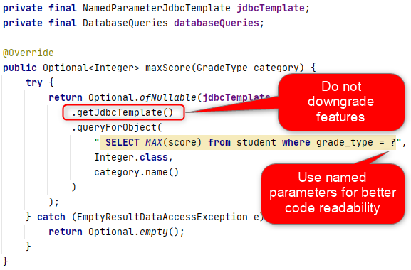
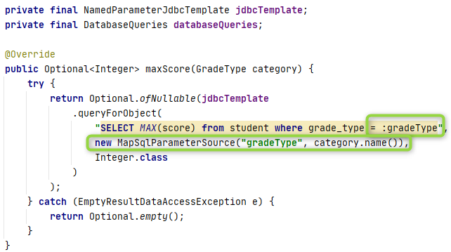
Use spring robustness

Slide 3
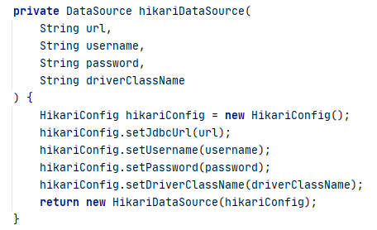
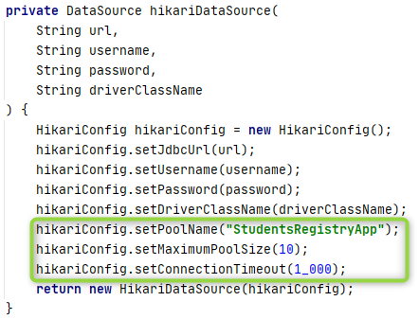
Prevent resource exhaustion. Tune pool

Slide 4
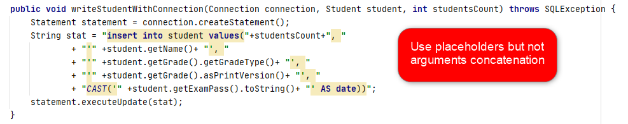
Remember security and performance

Slide 5
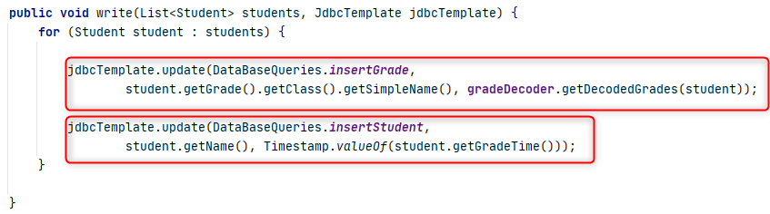
Prevent data inconsistency by transactions

Slide 6
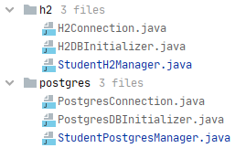
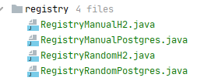
Prefer polymorphism over copy-paste

Slide 7
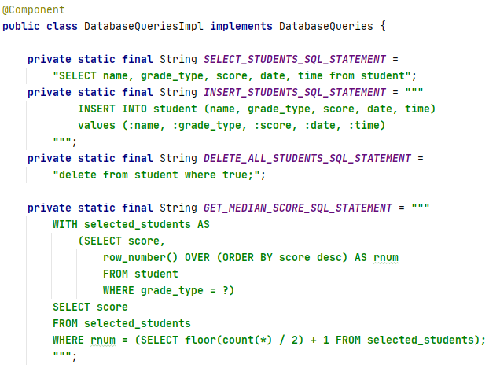
Keep code clean Maybe extract SQL to resources

Slide 8
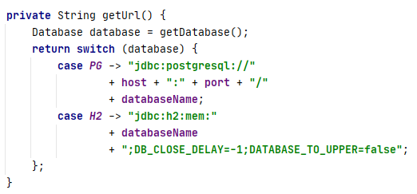
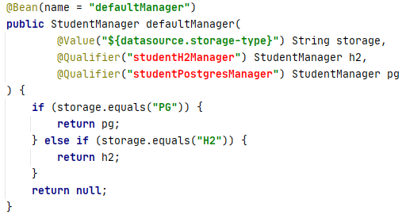
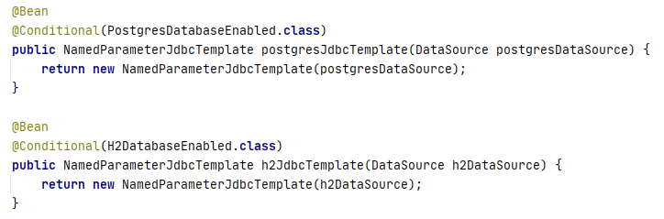
Try to be more open-close. Design some analog of Profiles

Slide 9
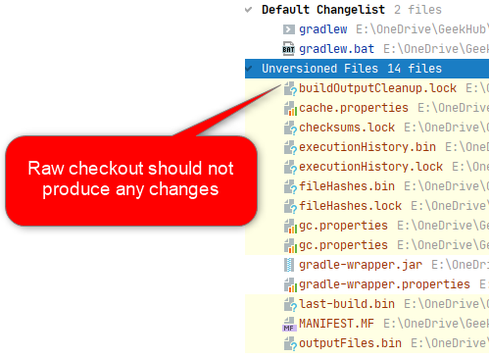
Obey your teammates

Slide 10
Thanks!
Any Questions?
Or find us in Slack:
@Yaroslav Brahinets
@Vasya Rudas

